Slide 1
The wayback machine
Sahand Sabour (山姆)
2022380024
2023年04月11日

Slide 2
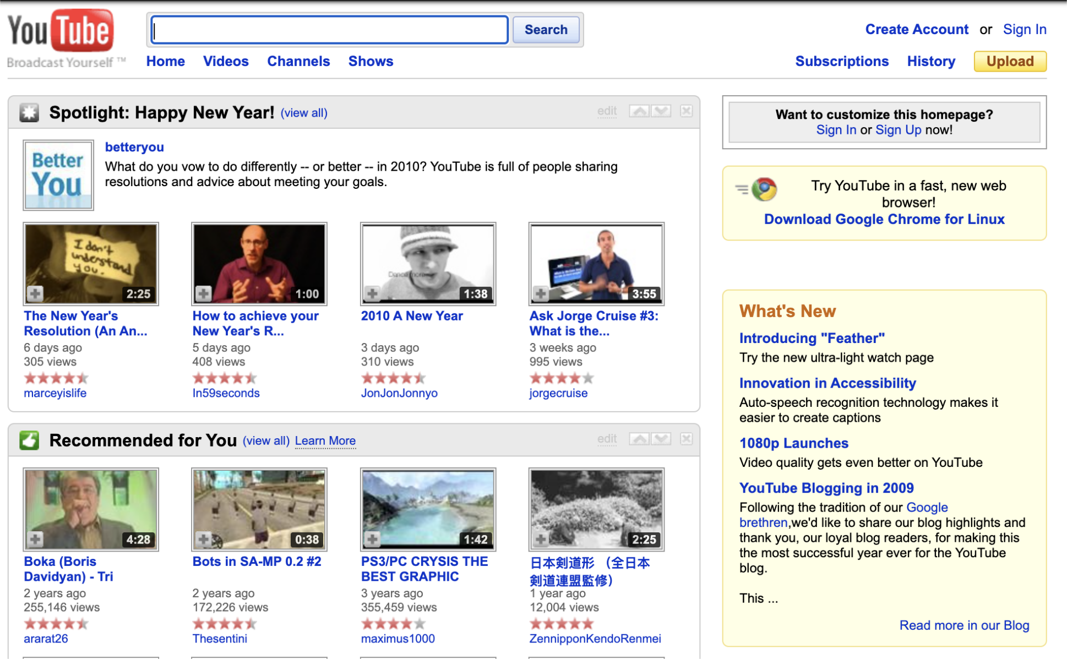
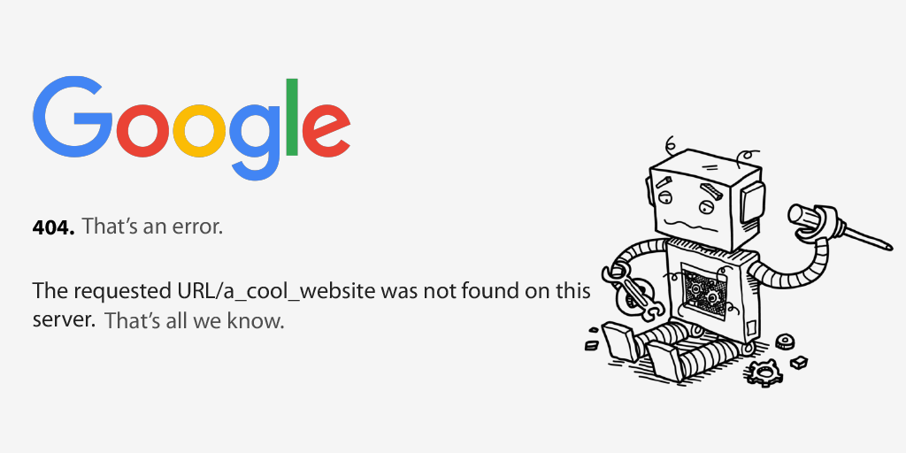
What is the wayback machine?
Have you ever wondered how a website has changed throughout the years?
What to do if what you were looking for is no longer available? (docID = -1)
Have you tried web.archive.org?

Slide 3
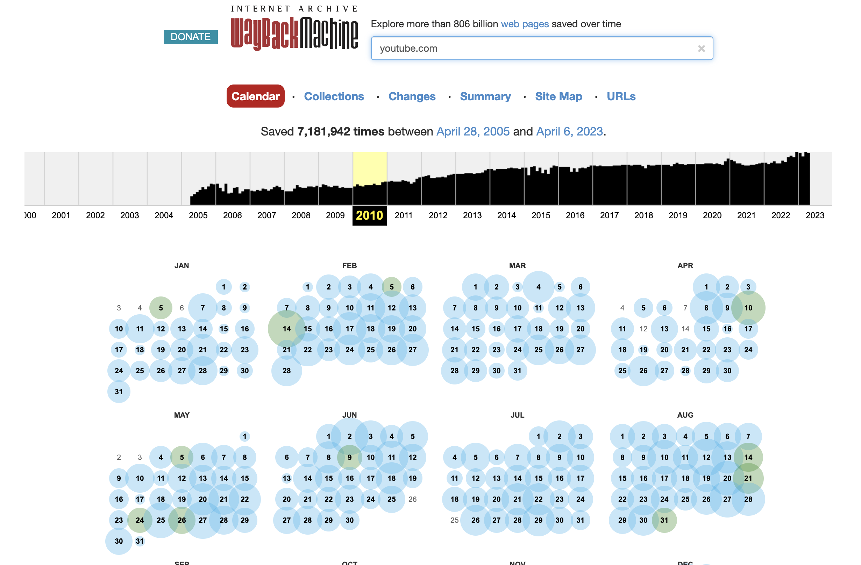
What is the wayback machine?
An internet archive that stores snapshots of websites from the past.
Created by the Internet Archive, a non-profit organization dedicated to preserving digital content.
Allows access historical versions of websites that may no longer exist or have been updated.
Used for research, historical preservation, and legal evidence.

Slide 4
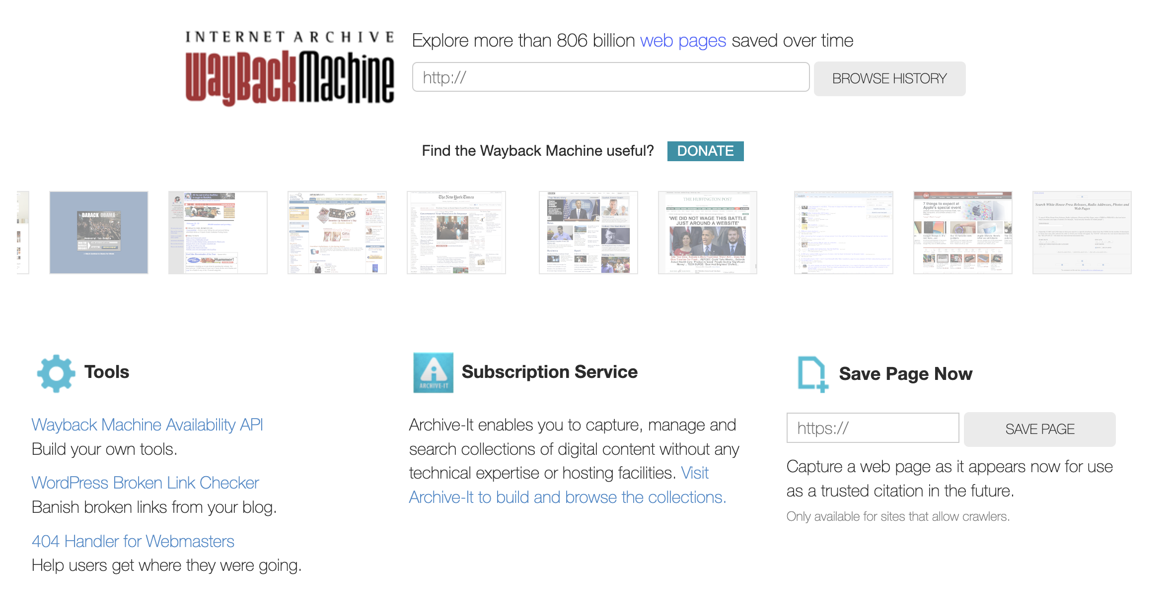
Why use the wayback machine?
1
2
3

Slide 5
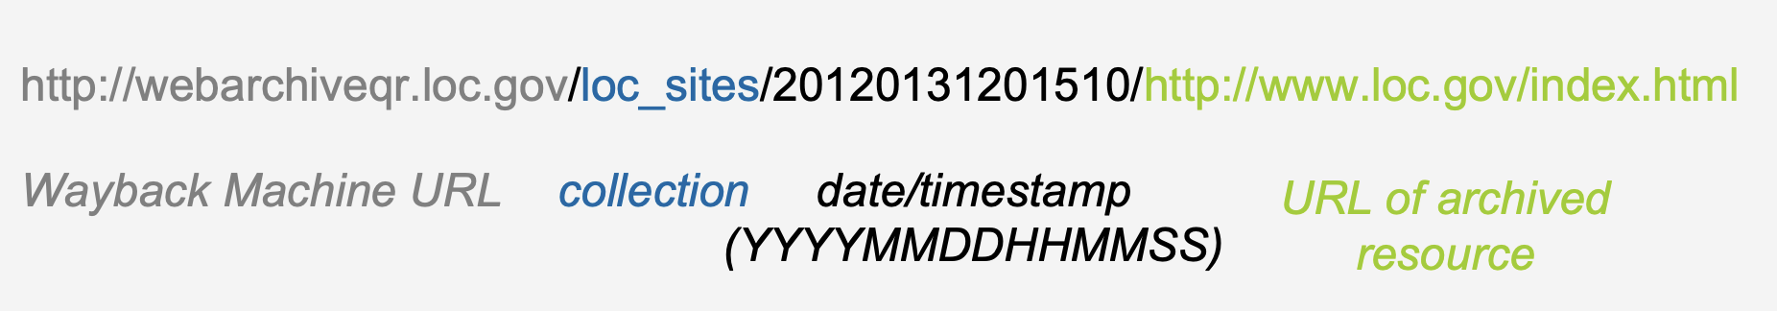
How does it work?
The Wayback Machine uses web crawlers to capture and store website data.
It archives websites at regular intervals, depending on their popularity and content changes.
Users can search for a website and view archived versions of it from different dates.
https://blogs.loc.gov/thesignal/files/2012/10/Using_Wayback_Machine_for_Research_2.pdf

Slide 6
How does it actually work?
Crawler
Also known as the Wayback Machine Spider, it visits websites and collects data by following their links.
It then caches this data in a searchable and accessible index.
Caching
They adopt a process called web chaing, which stores the webpages locally.
This enables quick and efficient access to webpages.
Deduplication
This process is adopted to reduce the amount of required storage for this archive.
They only store one page of pages that are identical or nearly identical.
Search:
The archives are organized by storing metadata, such as the date it was crawled, URL, and keywords.

Slide 7
Conclusions
The Wayback Machine: a valuable tool for preserving digital content.
It allows us to see how websites have changed over time.
It enables us to access the content that is no longer available.
Overall, it provides a glimpse into the evolution of the internet.

Slide 8
Thank you
any question?
Slides made by ChatGPT

